Slide 1

How to use (R on) Compute Canada: An introduction

Slide 2
Compute Canada?
Compute Canada leads the acceleration of research and innovation by deploying state-of-the-art advanced research computing (ARC) systems, storage and software solutions.

Slide 3
Compute Canada?
Compute Canada leads the acceleration of research and innovation by deploying state-of-the-art advanced research computing (ARC) systems, storage and software solutions.
Or in other words:
Compute Canada provide computer clusters that can run your days-long analyses without compromising your personal laptop survival!

Slide 4
Tons of ressources
Calcul Canada
https://www.computecanada.ca/?lang=fr
https://docs.computecanada.ca/wiki/Compute_Canada_Documentation/fr
Calcul Quebec
https://www.calculquebec.ca/
https://www.youtube.com/channel/UCtWVrQmCfknjjQTHYQvnDxw

Slide 5
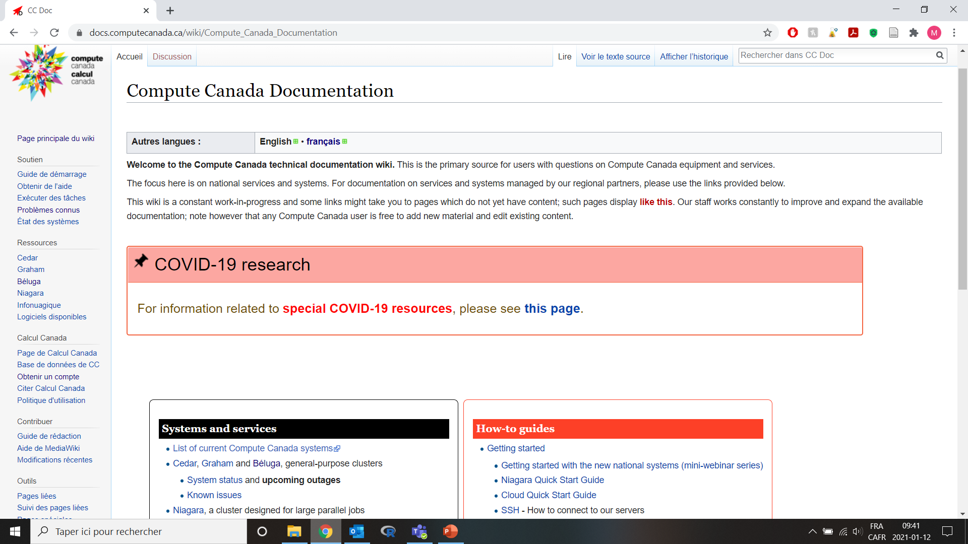

Slide 6
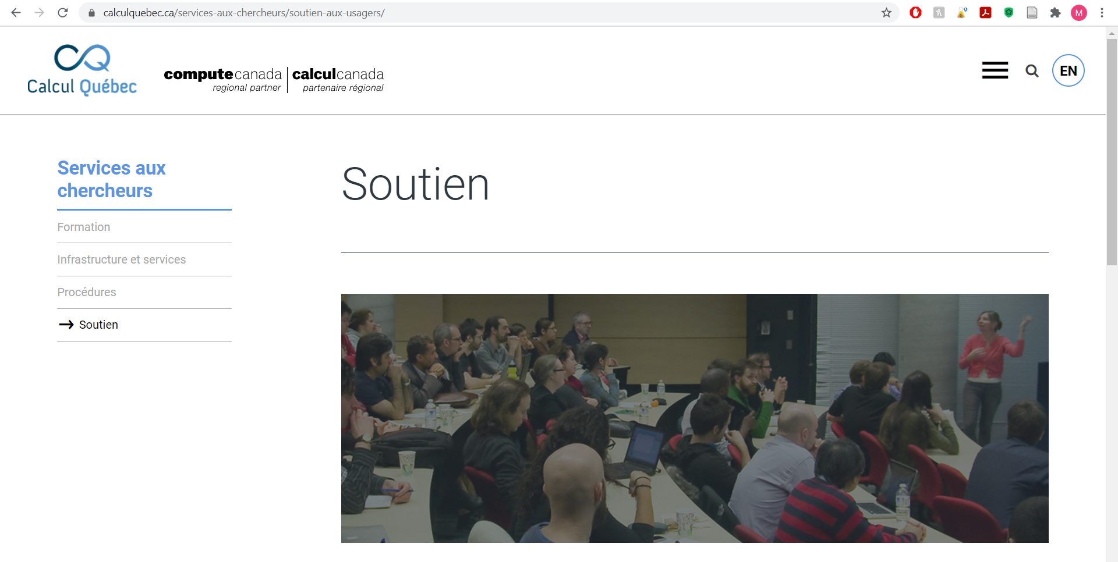

Slide 7
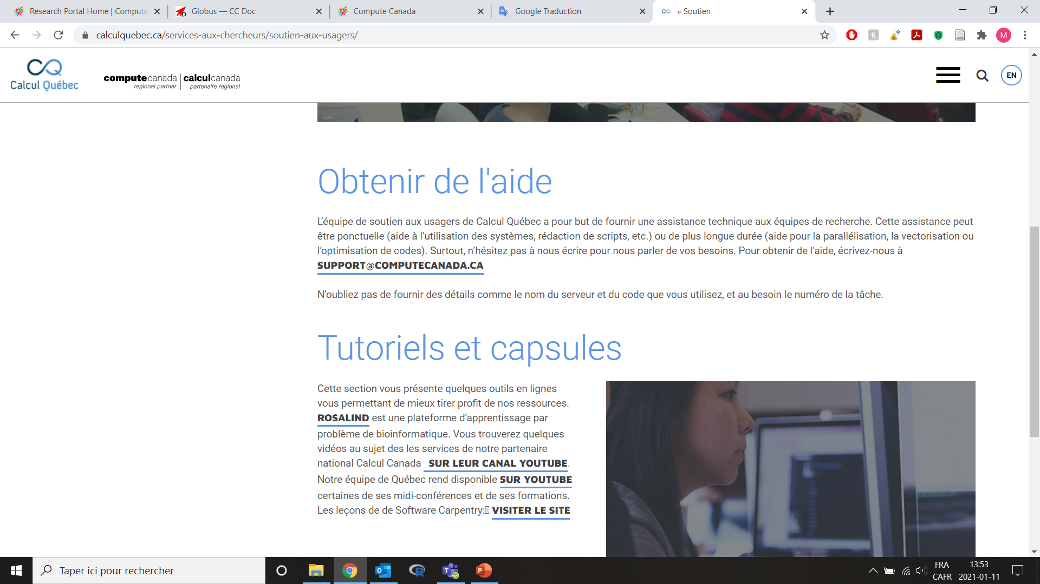

Slide 8
What are the steps to access Compute Canada?
It’s easy as 1, 2, 3 …
1 – Registration (you will need the CCRI code of your sponsor)
2 – Approval of your sponsor
3 – Wait the confirmation (~ 2 days after sponsor’s approval)

Slide 9

Everything is clearly described on the website

Slide 10
How can I use clusters of Compute Canada?
That is not as easy as 1, 2, 3 … but …
1 – Need to upload files on Compute Canada clusters (FileZilla)
2 – Need to submit jobs on Compute Canada clusters (Cygwin)
3 – Monitor jobs and download outputs back on your laptop (FileZilla)
I started to use Compute Canada years ago, so I’ll show you FileZilla and Cygwin, but I suggest you to be more proactive than I am and use Globus
https://docs.computecanada.ca/wiki/Globus

Slide 11
Install FileZilla
Installation of Filezilla
https://filezilla-project.org/, choose “Filezilla Client”

Slide 12
Install CygWin
http://cygwin.com/setup.exe
Be sure to select the openssh package during installation

Slide 13
How can I use clusters of Compute Canada?
That is not as easy as 1, 2, 3 … but …
1 – Need to upload files on Compute Canada clusters (FileZilla)
2 – Need to submit jobs on Compute Canada clusters (Cygwin)
3 – Monitor jobs and dowload outputs back on your laptop (FileZilla)
I started to use Compute Canada years ago, so I’ll show you FileZilla and Cygwin, but I suggest you to be more proactive than I am and move on using Globus
https://docs.computecanada.ca/wiki/Globus

Slide 14
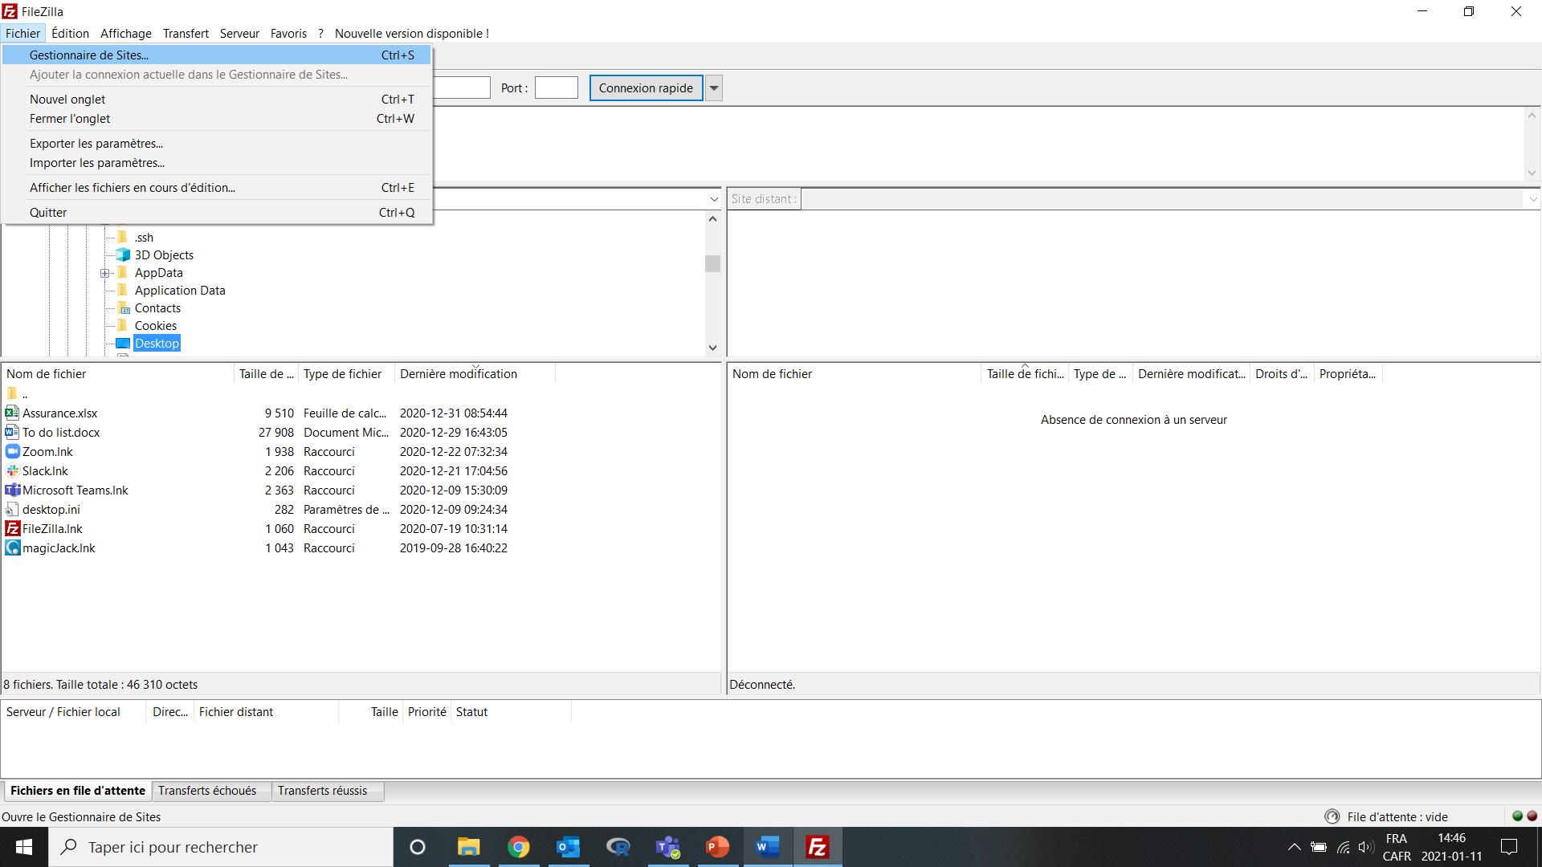
Transfer files to Compute Canada cluster
Open FileZilla

Slide 15
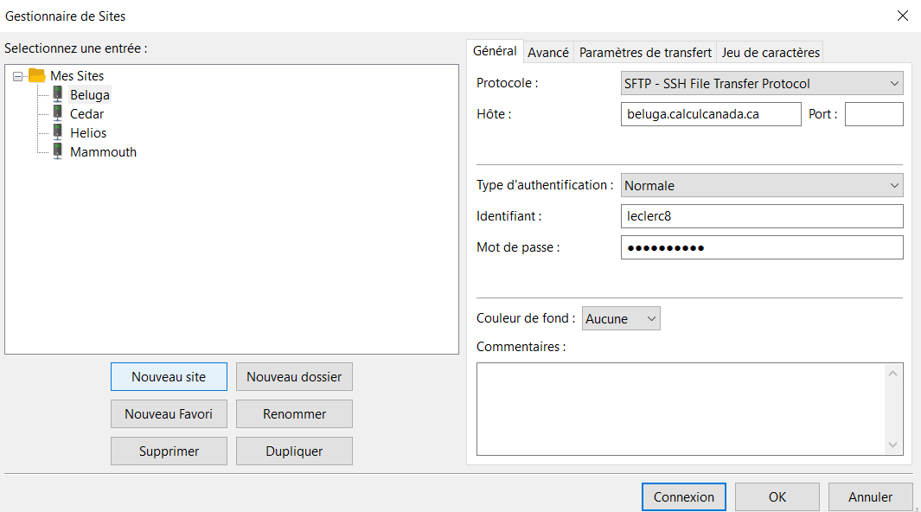
Transfer files to Compute Canada cluster
Open FileZilla
File
Site Manager?
New site
Fill info
Connect
Compute Canada cluster to reach
Compute Canada identifier

Slide 16
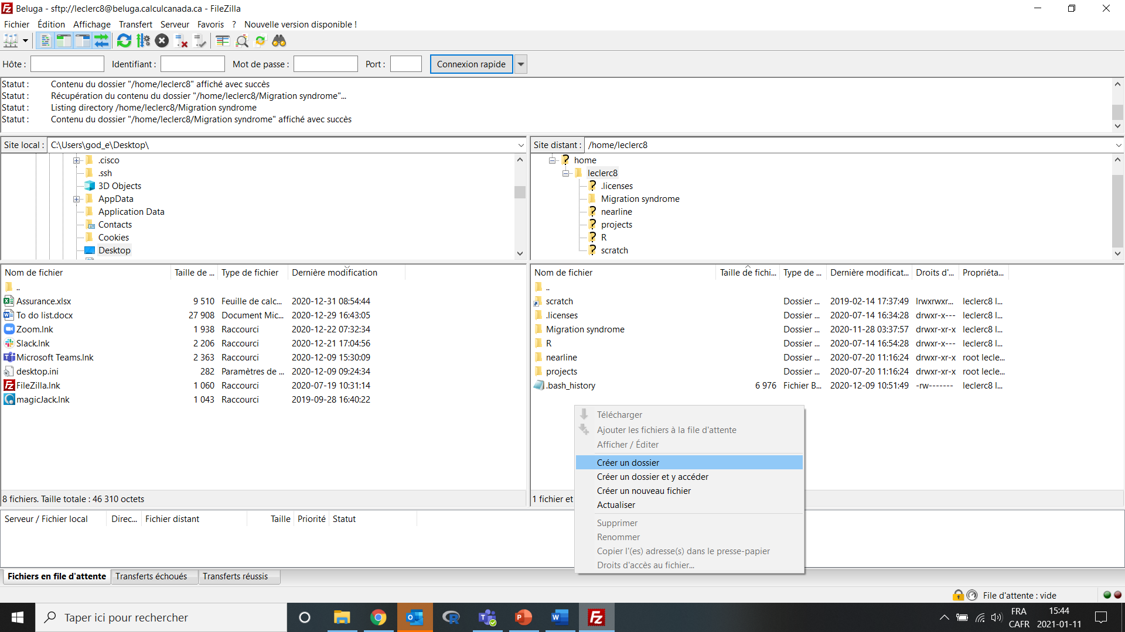
Transfer files to Compute Canada cluster
Open FileZilla
File
Site Manager?
New site
Fill info
Connect
Right click Create folder
Your computer
Compute Canada cluster

Slide 17
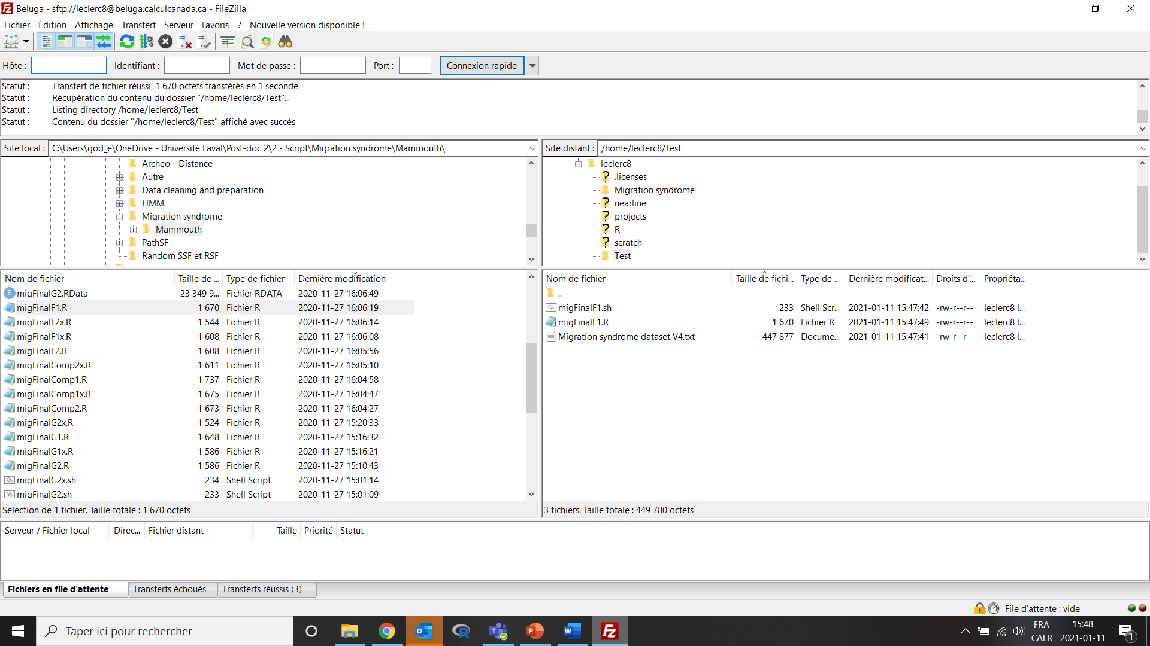
Transfer files to Compute Canada cluster
Open FileZilla
File
Site Manager?
New site
Fill info
Connect
Right click Create folder
Transfer files
.txt = my dataset
.R = R-script
.sh = bash script to specify the job on the cluster

Slide 18
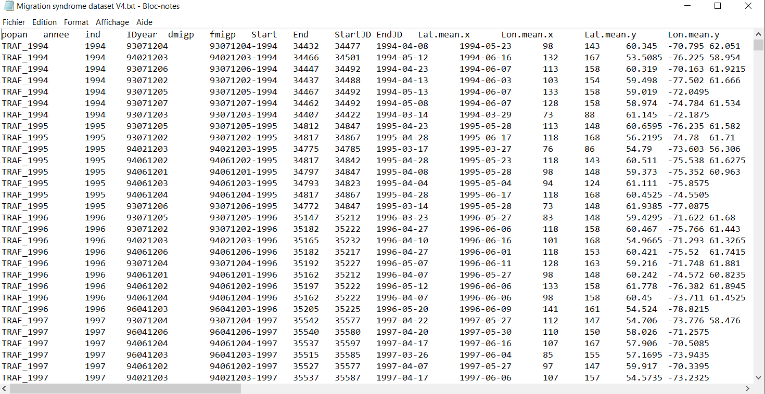
Transfer files to Compute Canada cluster
Dataset
.sh file = specify the job on the cluster
.R = R-script
.txt = my dataset

Slide 19
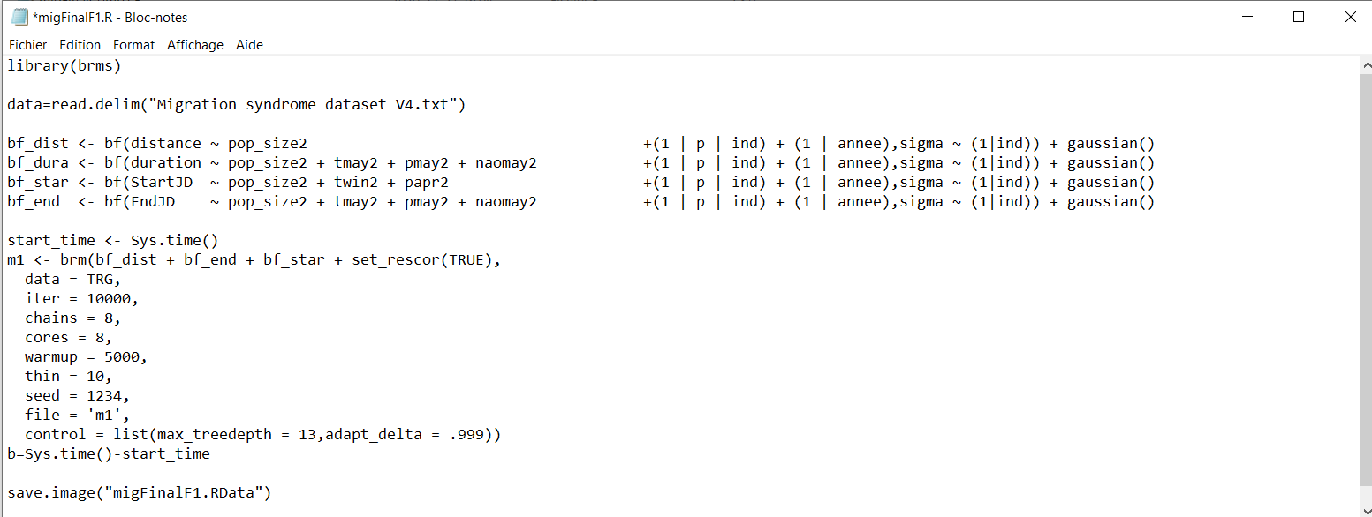
Transfer files to Compute Canada cluster
R-script
.sh file = specify the job on the cluster
.R = R-script
.txt = my dataset

Slide 20
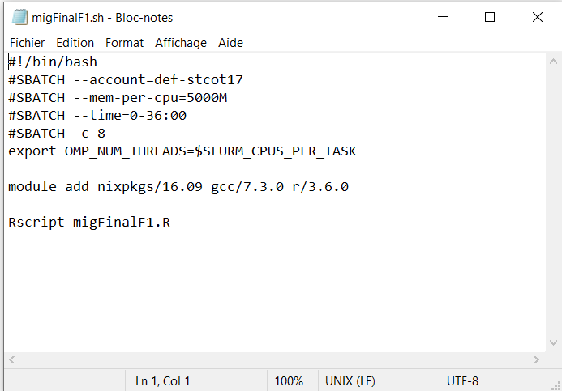
How to code the Bash script
Bash script

Slide 21
How to code the Bash script
Bash script
Don’t touch this line
Don’t touch this line

Slide 22
How to code the Bash script
Bash script
Don’t touch this line
Adjust using your sponsor group name
Don’t touch this line

Slide 23
How to code the Bash script
Bash script
Don’t touch this line
Adjust using your sponsor group name
Requiring 5000M of memory (ask for less if possible)
Don’t touch this line

Slide 24
How to code the Bash script
Bash script
Don’t touch this line
Adjust using your sponsor group name
Requiring 5000M of memory (ask for less if possible)
Asking for 36 hours, after the job will be kill
Don’t touch this line

Slide 25
How to code the Bash script
Bash script
Don’t touch this line
Adjust using your sponsor group name
Requiring 5000M of memory (ask for less if possible)
Asking for 36 hours, after the job will be kill
Asking for 8 cores
Don’t touch this line

Slide 26
How to code the Bash script
Bash script
Don’t touch this line
Adjust using your sponsor group name
Requiring 5000M of memory (ask for less if possible)
Asking for 36 hours, after the job will be kill
Asking for 8 cores
Don’t touch this line
Adding modules

Slide 27
How to code the Bash script
Bash script
Don’t touch this line
Adjust using your sponsor group name
Requiring 5000M of memory (ask for less if possible)
Asking for 36 hours, after the job will be kill
Asking for 8 cores
Don’t touch this line
Adding modules
Open R and read my script

Slide 28
How can I use clusters of Compute Canada?
That is not as easy as 1, 2, 3 … but …
1 – Need to upload files on Compute Canada clusters (FileZilla)
2 – Need to submit jobs on Compute Canada clusters (Cygwin)
3 – Monitor jobs and dowload outputs back on your laptop (FileZilla)

Slide 29
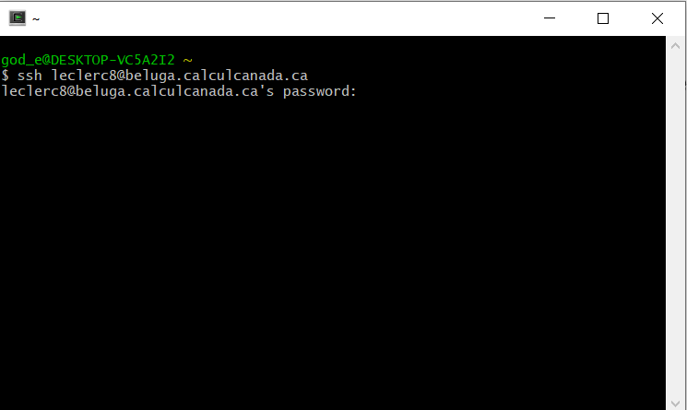
How to submit jobs on Compute Canada clusters
Transfer your R-script, Bash script, and database on the cluster with FileZilla and …
Open CygWin
Type: ssh username@beluga.calculcanada.ca
Type your password and press « Enter » Nothing appears when typing your password

Slide 30
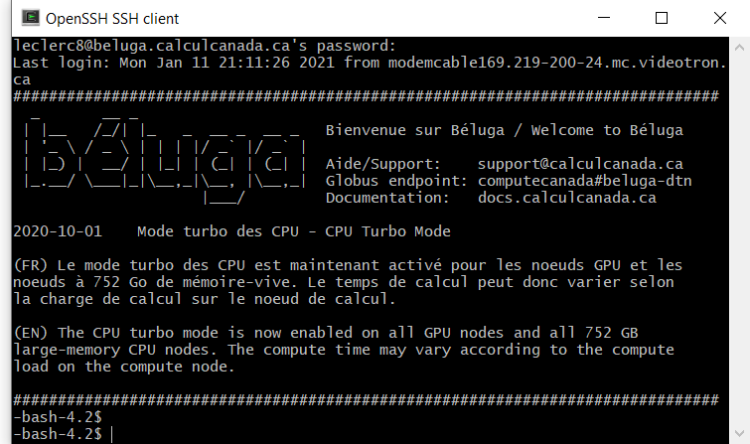
How to submit jobs on Compute Canada clusters
Transfer your R-script, Bash script, and database on the cluster with FileZilla and …
Open CygWin
Type: ssh username@beluga.calculcanada.ca
Type your password and press « Enter » Nothing appears when typing your password
You are now on Compute Canada cluster!
You’ll need few basic line of command to naviguate on the cluster and then you’ll be fine to launch your job!

Slide 31
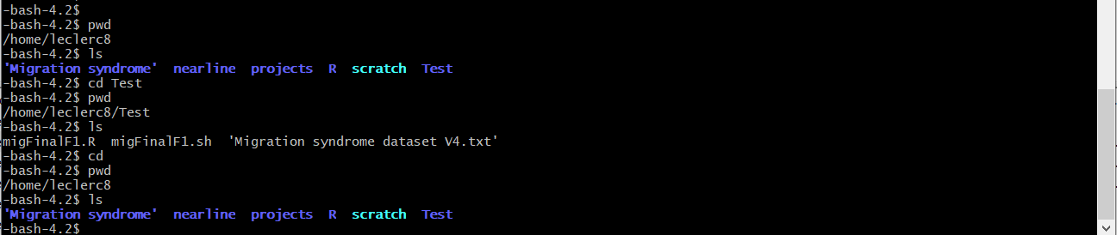
Few lines of command that will be helpful
- ls = list of files and folder available at this location
- pwd = to know where you are
- cd = to go to your home directory
- cd Test = access the Test folder

Slide 32
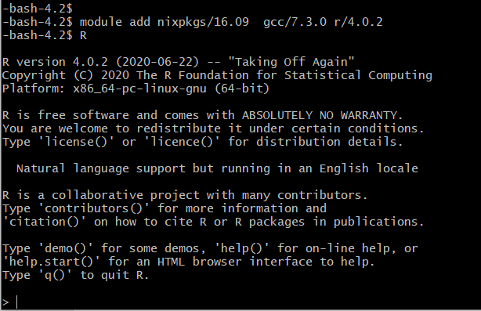
Few lines of command that will be helpful
- module avail = list of all modules (programs) available to run on the cluster
- module spider r/4.0.2 = Description, properties, and list of the dependencies of modules
For r/4.0.2 → Dependencies = nixpkgs/16.09 gcc/7.3.0
So type: module add nixpkgs/16.09 gcc/7.3.0 r/4.0.2
R
You are now in R, on the interactive node of
Compute Canada cluster

Slide 33
Few lines of command that will be helpful
- module avail = list of all modules (programs) available to run on the cluster
- module spider r/4.0.2 = Description, properties, and list of the dependencies of modules
For r/4.0.2 → Dependencies = nixpkgs/16.09 gcc/7.3.0
So type module add nixpkgs/16.09 gcc/7.3.0 r/4.0.2
R
You are now in R, on the interactive node of
Compute Canada cluster
Install all packages needed now!
The interactive node allows you to install packages,
but it’s not possible when the job is running.

Slide 34
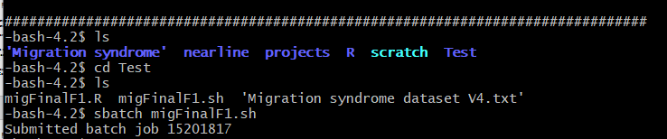
It is time to submit your job!
Go to the folder where your scripts and database(s) are using « pwd » and « cd » command
- sbatch = submit job on the cluster – need to specify the .sh file name
The time it will take before your job will start will be determined by the scheduler!
Depends on Number of cores, memory, and time requested
Other job request
The number of requests your have done recently
Your cpu-year usage … etc.

Slide 35
How can I use clusters of Compute Canada?
That is not as easy as 1, 2, 3 … but …
1 – Need to upload files on Compute Canada clusters (FileZilla)
2 – Need to submit jobs on Compute Canada clusters (Cygwin)
3 – Monitor jobs and download outputs back on your laptop (FileZilla)

Slide 36
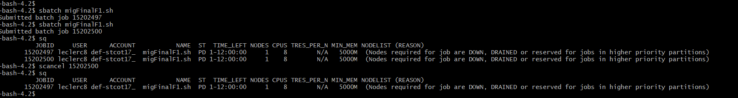
Monitor your job
Again, few lines of command that will be helpful
- squeue = supplies information about all jobs in the system
- sq = supplies information about your own jobs
- scancel jobID = Cancel job – need to specify jobID

Slide 37
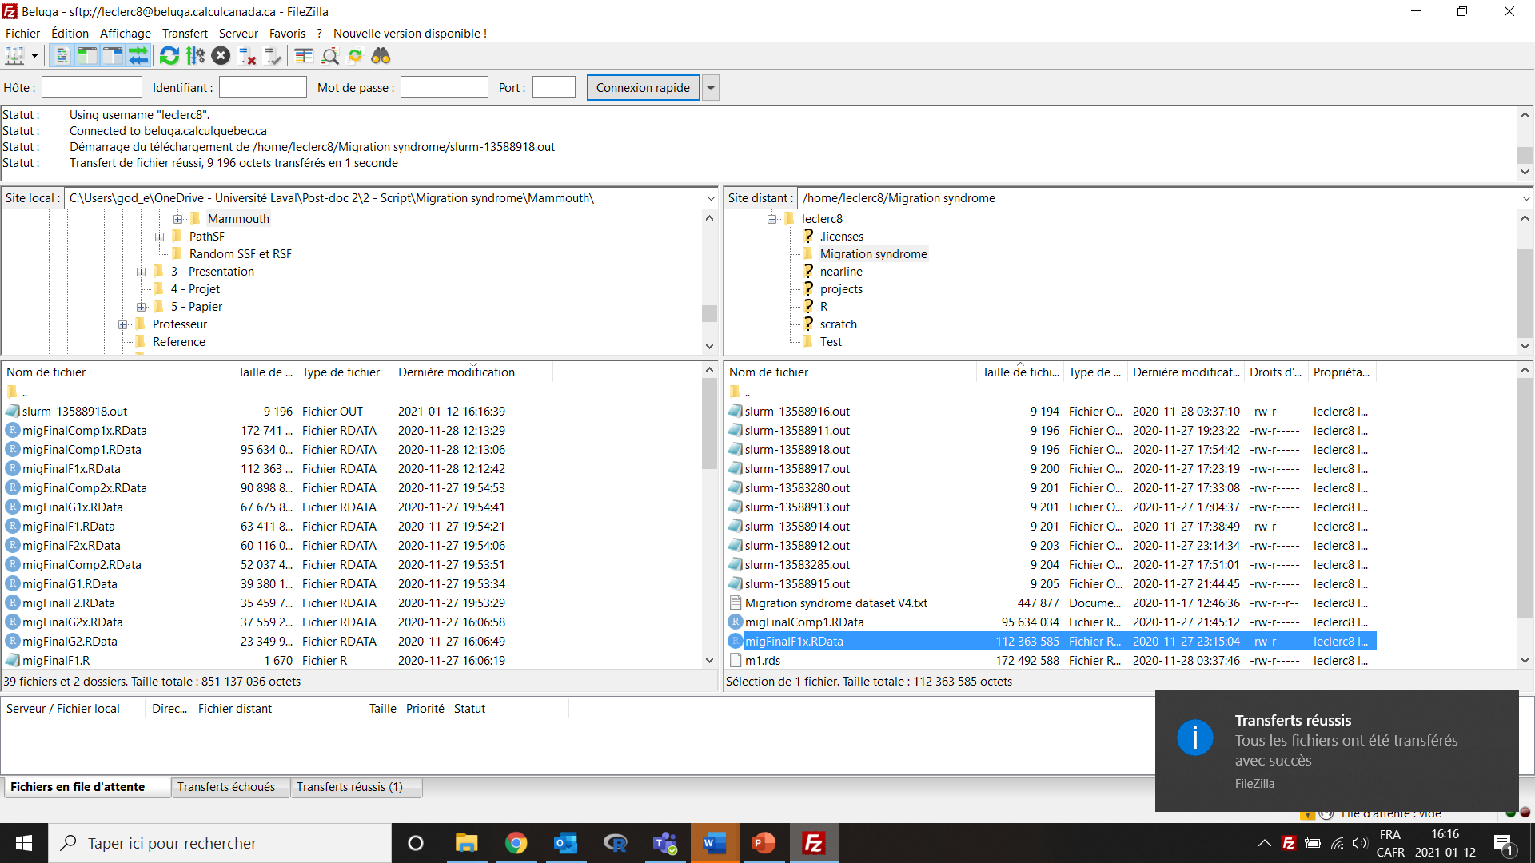
Transfer files from Compute Canada cluster
Open FileZilla
Connect to
cluster
Drag and drop
files on your computer
Your computer
Compute Canada cluster

Slide 38
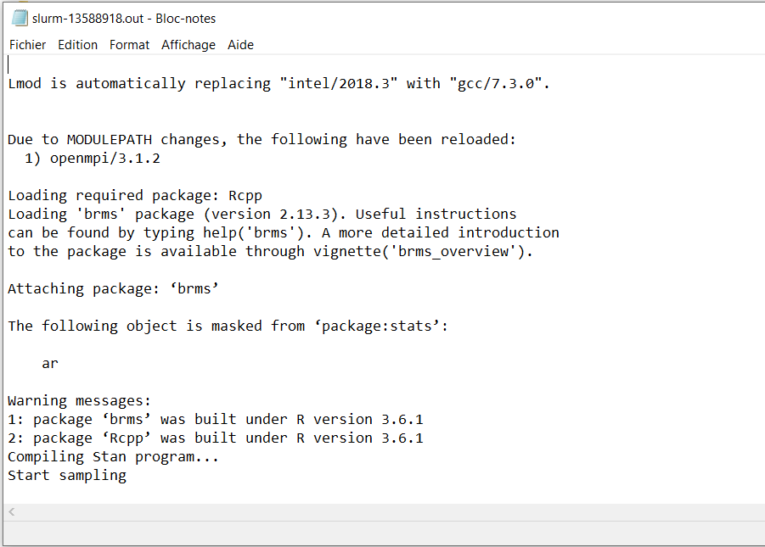
Transfer files from Compute Canada cluster
Open FileZilla
Connect to
cluster
Drag and drop
files on your computer
Slurm file
Your computer

Slide 39
Base loop Parallel
library(doParallel);library(foreach)
numCores <- detectCores()
registerDoParallel(numCores)
foreach (i=1:nrow(sunpos_jasper_day)) %dopar% {
subset <- sunpos_jasper_day[i, ]
sv <-normalvector(subset$alt,subset$azi)
Shade <- doshade(dem_jasper, sv)
writeRaster(Shade,paste("jasper_shade_",i,".tif",sep=""))
}
If you run this on your computer, use numCores-1 to free up one core so you can still use your computer for other tasks other wise your computer will freeze
for(i in 1:nrow(sunpos_jasper_day)){
subset <- sunpos_jasper_day[i, ]
sv <-normalvector(subset$alt,subset$azi)
Shade <- doshade(dem_jasper, sv) writeRaster(Shade,paste("jasper_shade_",i,".tif",sep=""))
}
https://nceas.github.io/oss-lessons/parallel-computing-in-r/parallel-computing-in-r.html

Slide 40
Tons of ressources
Calcul Canada
https://www.computecanada.ca/?lang=fr
https://docs.computecanada.ca/wiki/Compute_Canada_Documentation/fr
Calcul Quebec
https://www.calculquebec.ca/
https://www.youtube.com/channel/UCtWVrQmCfknjjQTHYQvnDxw

